Slide 1
Online Voting System
For conducting polls and surveys that can handle concurrent votes and stores voting results

Slide 2
Group Members
Arnab Ghosh 2322019042
Fardin Ahmed 2323806642

Slide 3
Content Layout with List
Introduction
Functionality of the each Classes
Technicalities
Conclusion

Slide 4
Introduction
Describing online voting System

Slide 5
Online Voting System
The online voting system is a multi-threaded application designed to facilitate secure and efficient voting processes for both polls and surveys. It allows users to cast votes concurrently, simulating real-time voting scenarios. The system supports two type of voting:
Polls: Fixed options ( strongly agree, agree, etc)
Surveys: Customizable options, including open-ended responses for additional suggestions

Slide 6

Functionality of Each Classes
Describing the classes: voting, polls, surveys, vote thread and main class

Slide 7
Functionalities of Voting class:
Functionalities | Description
Storing the question | Stores the voting question in “question” for both polls and surveys
Tracking total votes | Tracks the total number of votes cast in “totalvotes”
Abstract Methods | Ensures all subclasses implement “castVotes” and “displayResults”
File Saving (SaveToFile) | Provides a reusable, thread-safe way to save voting data to files persistently

Slide 8
Functionalities of Polls class (Subclass of Voting):
Functionalities | Description
Implements Fixed Options | Supports voting on four fixed options “a”, “b”, “c” and “d”
Tracks Individual Votes | Maintains counters (a_votes , b_votes , c_votes , d_votes) for each option
Implements “castVotes()” | Handles vote casting and updates the respective counters
Implements “displayResults()” | Outputs poll results for all options and the total votes

Slide 9
Functionalities of Surveys class (Subclass of Voting):
Functionalities | Description
Support Custom Options | Allows dynamic creation of survey options during runtime
Tracks Option Votes | Uses an array(votes) to store vote counts for each survey option
Implements “castVotes()” | Maps a user’s vote to the correct option and updates the respective counter
Implements “displayResults()” | Display results for all custom options and total votes.

Slide 10
Functionalities of VoteThread:
Functionalities | Description
Thread Handling for Votes | Handles voting operations in a separate thread for each vote
Links to Voting System | Takes a “voting” object and a vote option as input for concurrent execution
Implements “run()” | Calls “castVotes()” on the provided “Voting” object

Slide 11
Functionalities of OnlineVotingSystem (Main Class):
Functionalities | Description
User Input Handling | Accepts user input to choose between polls and surveys or to stop the system
Creates Polls/Surveys | Instantiates “Polls” or “Surveys” based on user choice and questions/options
Spawns Threads | Creates and starts “VoteThread” for each user vote
Displays Results | Call “displayResults()” on the “Voting” object after voting ends
Handles Open-Ended Questions | Collects user responses for additional suggestions and saves them to file

Slide 12
Technicalities
Explaining the intricacies of the project

Slide 13
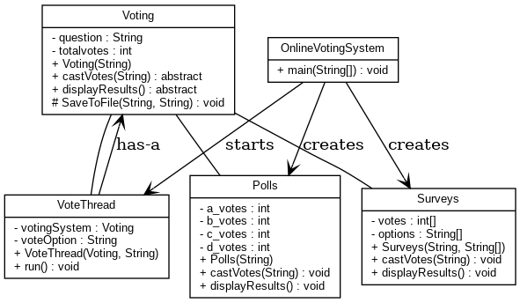
UML Diagram

Slide 14
How the program conducts Polls and Surveys
Polls
Users are prompted to vote on predefined options: a (Hard Agree), b (Agree), c (Disagree), or d (Hard Disagree)
Each vote is processed in a separate thread (VoteThread), updating counters for the chosen option.
Results are displayed with vote counts for each option and the total votes
Surveys
Users can define questions and create custom options
Votes for these options are tracked in an array, with each thread updating the respective counter
User can also answer open-ended questions, with their responses saved to a file
Results show votes for all options and total participation

Slide 15
Implementing Multi-threading for handling concurrent votes
Each vote is processed in its own thread using the “VoteThread” class
Threads call the “castVotes()” method concurrently, allowing multiple users to vote simultaneously
Shared resources like vote counters and file writers are synchronized to prevent conflicts
The “SaveToFile()” method ensures safe, non-overlapping files writes
After threads finish, the main thread compiles and displays results

Slide 16
How voting results are stored in Files
The “SaveToFile()” method in the “voting” class append voting data to a file
It uses “FileWriter” with the “append” mode set to “True”
For polls, each vote is saved as a line in “pollresults.txt”
For surveys, custom vote options are saved in “surveyresults.txt”
User suggestions or answers are stored in “openEndedResponses.txt”

Slide 17
Conclusion
Summary of the project

Slide 18
In a nutshell
The Online Voting System successfully demonstrates how multithreading can be leveraged to handle concurrent voting efficiently. By ensuring thread safety and scalability, the system provides a robust platform for conducting polls and surveys in real time. Its ability to handle both fixed and customizable voting options, along with secure file storage, makes it a practical solution for modern voting needs. This project showcases a seamless integration of concurrency, synchronization, and user interaction, delivering a reliable and dynamic voting experience.

Slide 19
Thank you for watching our Presentation!

